Slide 1
Language Detection System Using Machine Learning
Team ETA
Zarnab Zafar, Muhammad Mustafa Shah, Ayesha Majeed, Wajahat Hussain, Dil Nawaz, Muhammad AbuBakar, Ali Khan

Slide 2
Introduction
Language detection is a critical task in Natural Language Processing (NLP), enabling applications like:
Machine translation
Search engines
Content analysis
Traditional methods face limitations with short or mixed texts, making Machine Learning a powerful alternative.

Slide 3
Traditional Approaches
Rule-based methods are limited in handling:
Short texts
Mixed-language content
Noisy data
Machine Learning approaches help overcome these challenges by learning from large datasets.

Slide 4
Machine Learning for Language Detection
Machine Learning models, such as Naive Bayes and Support Vector Machines (SVM), offer flexibility in handling:
Complex patterns
Short texts
Mixed languages in noisy environments.

Slide 5
Problem Statement
Traditional approaches fail in scenarios involving short, mixed-language content. A robust Machine Learning-based solution is required to ensure high accuracy.

Slide 6
Objectives
Develop a machine learning system to detect languages with high accuracy.
Evaluate Naive Bayes and SVM models.
Provide recommendations for model optimization.
Explore real-world applicability.

Slide 7
Dataset Description
The dataset consists of text samples from 17 languages, including English, French, Spanish, Portuguese, Russian, and Arabic.
Each text sample is labeled with its respective language, allowing for supervised learning.

Slide 8
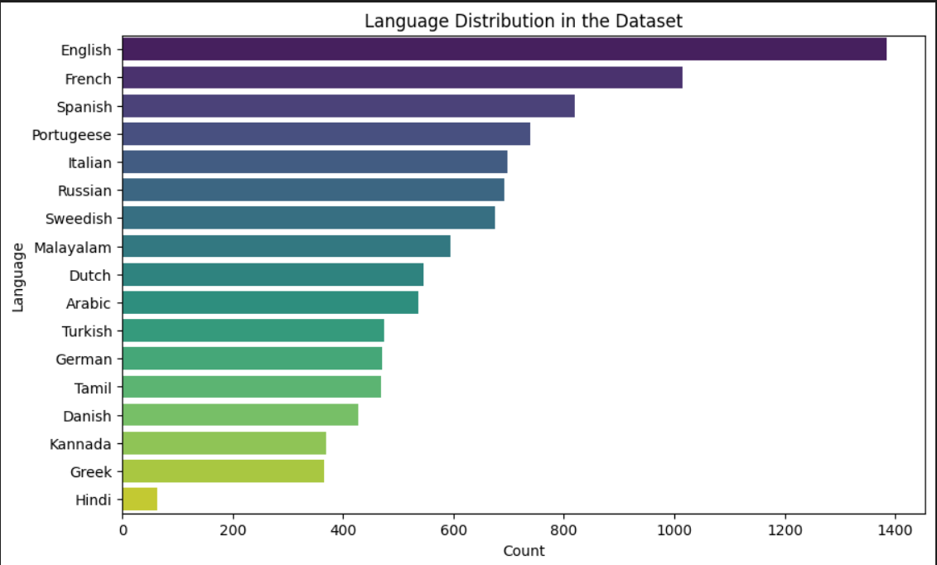
Data Analysis
Exploratory Data Analysis was performed to identify imbalances in the dataset and to understand the distribution of text samples across the 17 languages.

Slide 9
Data Preprocessing
Key steps in preprocessing included:
Stop word Removal: Eliminating common words like 'the', 'and', 'in'.
TF-IDF Vectorization: Converting text into numerical features.

Slide 10
Model Selection
Two machine learning models were selected:
Naive Bayes: A simple, efficient model for text classification.
SVM: Suitable for high-dimensional data like text.

Slide 11
Training and Testing
The dataset was split into training and testing sets. Both models were trained on the training set and tested to assess performance.

Slide 12
Evaluation Metrics
Metrics used to evaluate the models included:
Accuracy
Confusion Matrix
Precision, Recall, F1-score

Slide 13
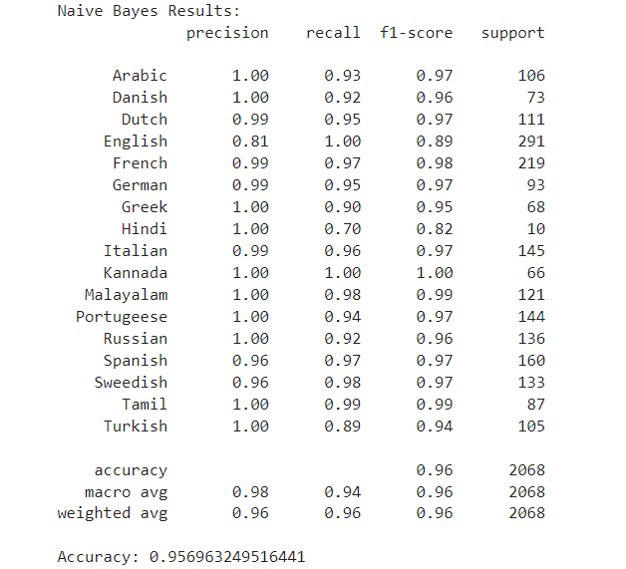
Naive Bayes Model Results
Naive Bayes achieved 95.6% accuracy, excelling in identifying language patterns and handling noisy data.

Slide 14
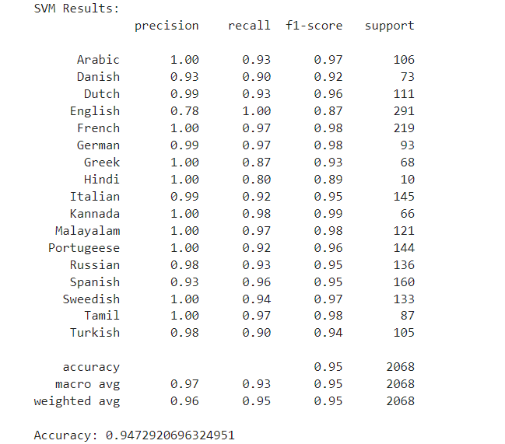
SVM Model Results
SVM achieved 94.7% accuracy, performing well with short texts but slightly underperforming compared to Naive Bayes.

Slide 15
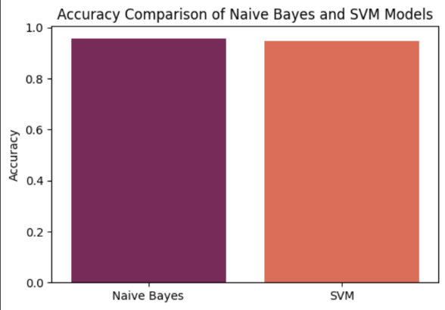
Model Comparison
Comparison between Naive Bayes and SVM showed that Naive Bayes had slightly better accuracy, particularly with noisy language data.

Slide 16
Confusion Matrix
The confusion matrix for both models provided insight into where each model struggled. Some languages were misclassified more often, particularly those with similar structures.

Slide 17
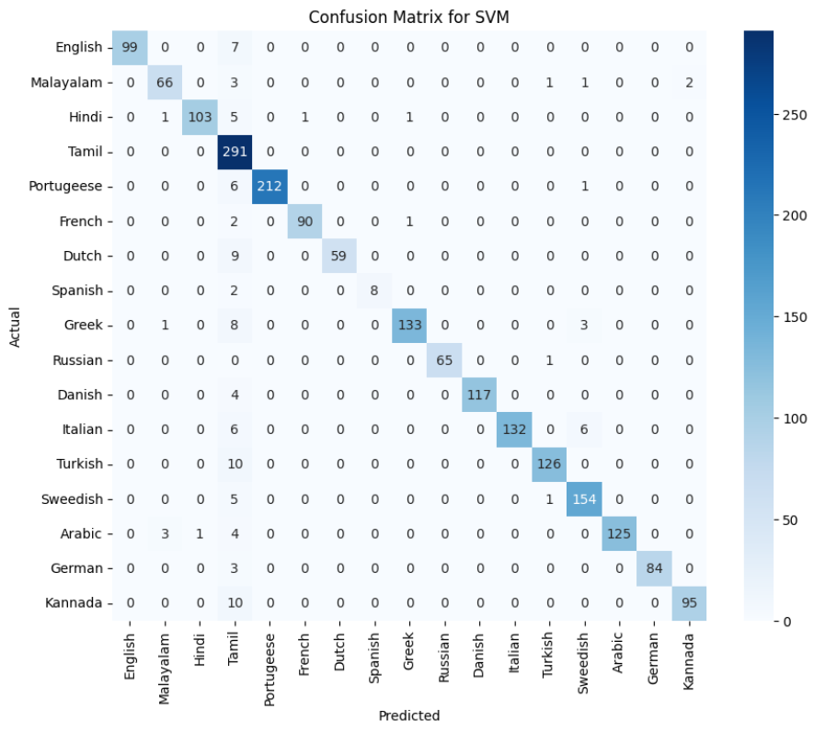
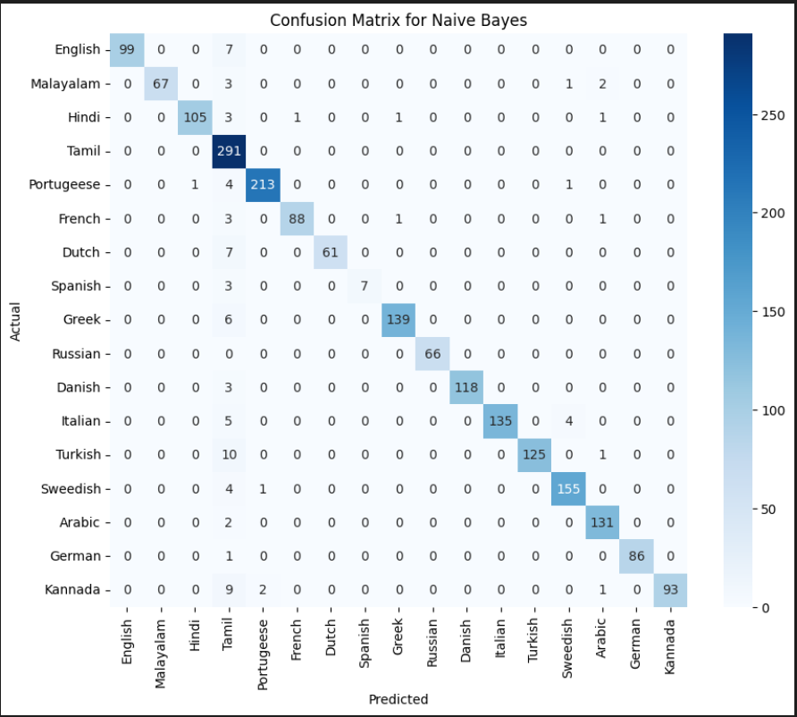

Slide 18
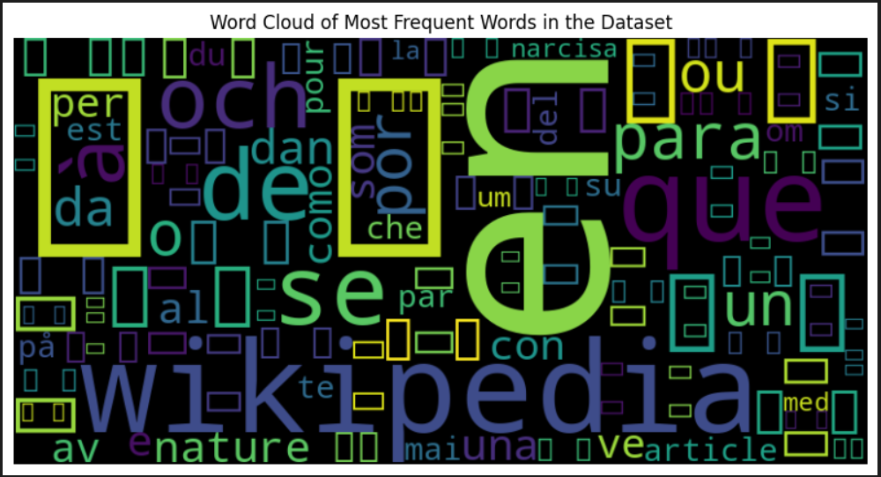
TF-IDF Word Cloud
The word cloud generated using TF-IDF scores highlights the most important words across the dataset, revealing which terms contributed most to the model's predictions.

Slide 19
Conclusion
Both Naive Bayes and SVM models proved effective for language detection, with Naive Bayes slightly outperforming SVM in terms of accuracy and handling complex data.

Slide 20
Future Work
Future improvements could include:
Hyperparameter tuning for both models.
Expanding the dataset with more diverse language samples.
Integration with real-world translation services.

Slide 21
Real-World Application
This language detection system can be integrated into applications such as:
Automatic translation pipelines.
Search engines and content categorization systems.

Slide 22
Q&A
Questions?

